Slide 1
HR Attrition Analysis Report
By: Samuel A. Opoku

Slide 2
Project Overview
This analysis aims at providing insight into the Attrition Rate of a hypothetical data by analyzing various aspect to identify trends and make data driven decisions and get deep understanding of worker leaving the organization tends to be.

Slide 3
Data Source
The primary data used for the analysis is a hypothetical data sourced from Kaggle

Slide 4
Tools
For this analysis, Microsoft Excel and Power BI was used for cleaning, mining, analyzing, and visualizing using Power Query, Power View

Slide 5
Data Preparation
The data was prepared for analysis and it was ensured the data was clean by;
loading and inspecting the data
deleting all duplicated entries
formatting the data into the appropriate types, (texts are in proper format, all unnecessary spaces and special characters were removed and numbers were in numbers format)
Creating new columns
replacing missing values.

Slide 6
Exploratory Data Analysis (EDA)
The data was further explored to find the following KPIs;
What was the Employee Count?
What was the Attrition Count?
What was the Attrition Rate?
What was Total number of Active Employees?
What was the Average Age?

Slide 7
Exploratory Data Analysis (EDA)
The data was further explored to find trends in;
Attrition by Gender
Attrition by Department
Number of Employees by Age Group
Job Satisfaction Ratings
Attrition by Field of Education
Attrition by Gender for different Age Groups
Attrition by Distance to work
Attrition by Performance
Attrition by Level of Education
Attrition by Marital Status
Attrition by Business Travel
Attrition by whether an employee work overtime or not

Slide 8
Data Analysis
To find the number of employees who have left the organization, responses Yes and No were changed to 1 and 0 respectively, and were then counted.
To find the Age Groups, the Ages of the Employees were put in an age bracket.
New Measures were computed to calculate the Attrition Rate in percentage
Charts were also used for further analysis

Slide 9
Results & Findings
After the analysis, it was found that,
The Overall Employees were 1470, those who had left the organization were 237 with 1233 Active Employees
The Attrition Rate was 16% and the Average Age was found to be 37 years.
Department-wise, about 56% Employees from the R&D Department had left the Organization while 5% employees from the HR department left.
Also, most Employees with Education in Life Science left the organization. 89 of the Employees who left the organization were with Life Science Education background.
Of those who left the organization, 47% were Females while 53% of them were Males.
Most Employees who left the organization were between the ages 25 – 34
Sales Representatives are those who are more satisfied with their Job.
Most employees who left the organization were those who were single
Most employees who leave near-by the left the job. There were 144 employees who left the job who were leaving near by the job.

Slide 10
Results & Findings
After the analysis, it was found that,
The Overall Employees were 1470, those who had left the organization were 237 with 1233 Active Employees
The Attrition Rate was 16% and the Average Age was found to be 37 years.
Department-wise, about 56% Employees from the R&D Department had left the Organization while 5% employees from the HR department left.
Also, most Employees with Education in Life Science left the organization. 89 of the Employees who left the organization were with Life Science Education background.
Of those who left the organization, 47% were Females while 53% of them were Males.
Most Employees who left the organization were between the ages 25 – 34
Sales Representatives are those who are more satisfied with their Job.

Slide 11
Results & Findings Con’t
Most employees who left the organization were those who were single, they were 120
Most employees who leave near-by the left the job. There were 144 employees who left the job who were staying closer to the organization.
156 employees who barely embark on business travel left the organization.
For about 200 employees who left the organization are those whose performance were on the job were low with only 37 of those who left were employees with high performance.

Slide 12
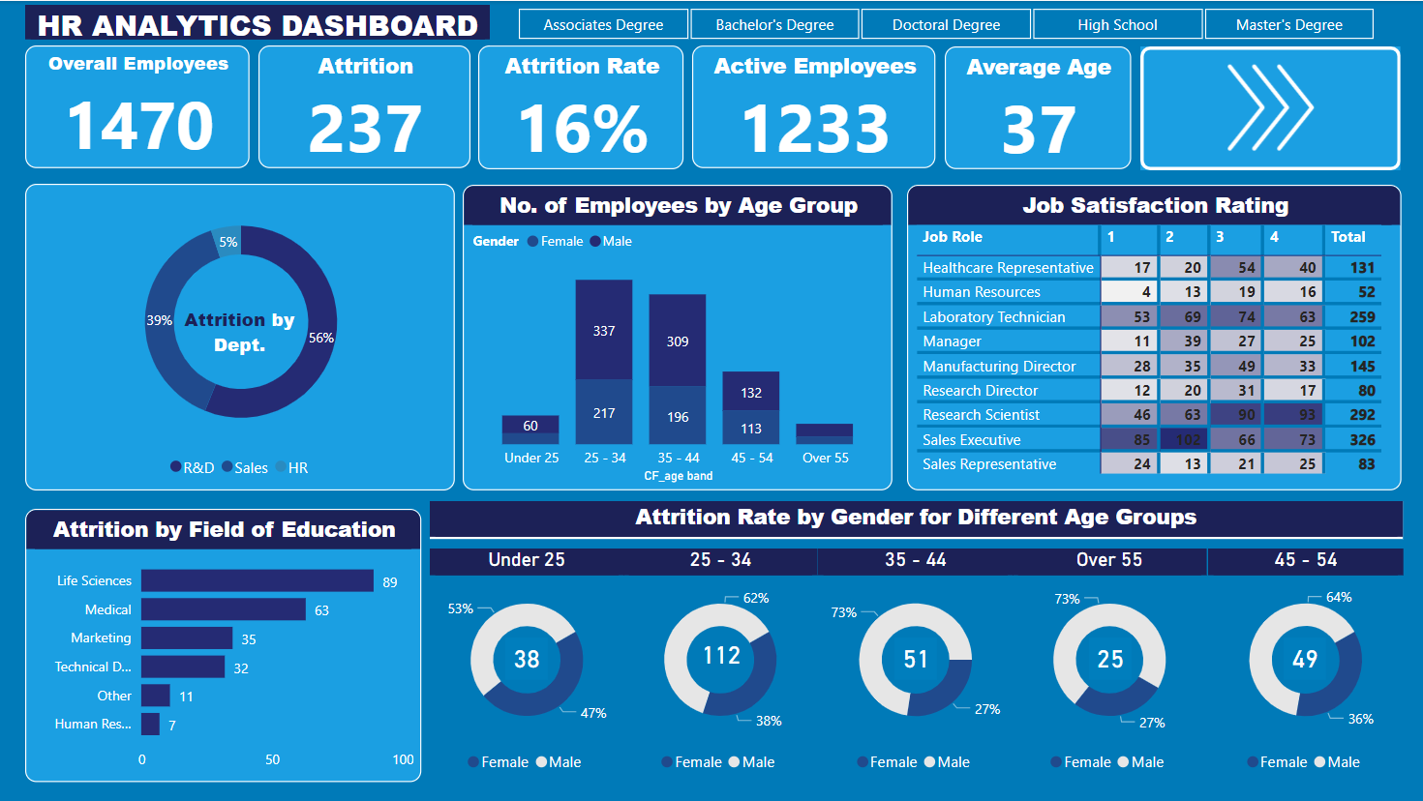

Slide 13
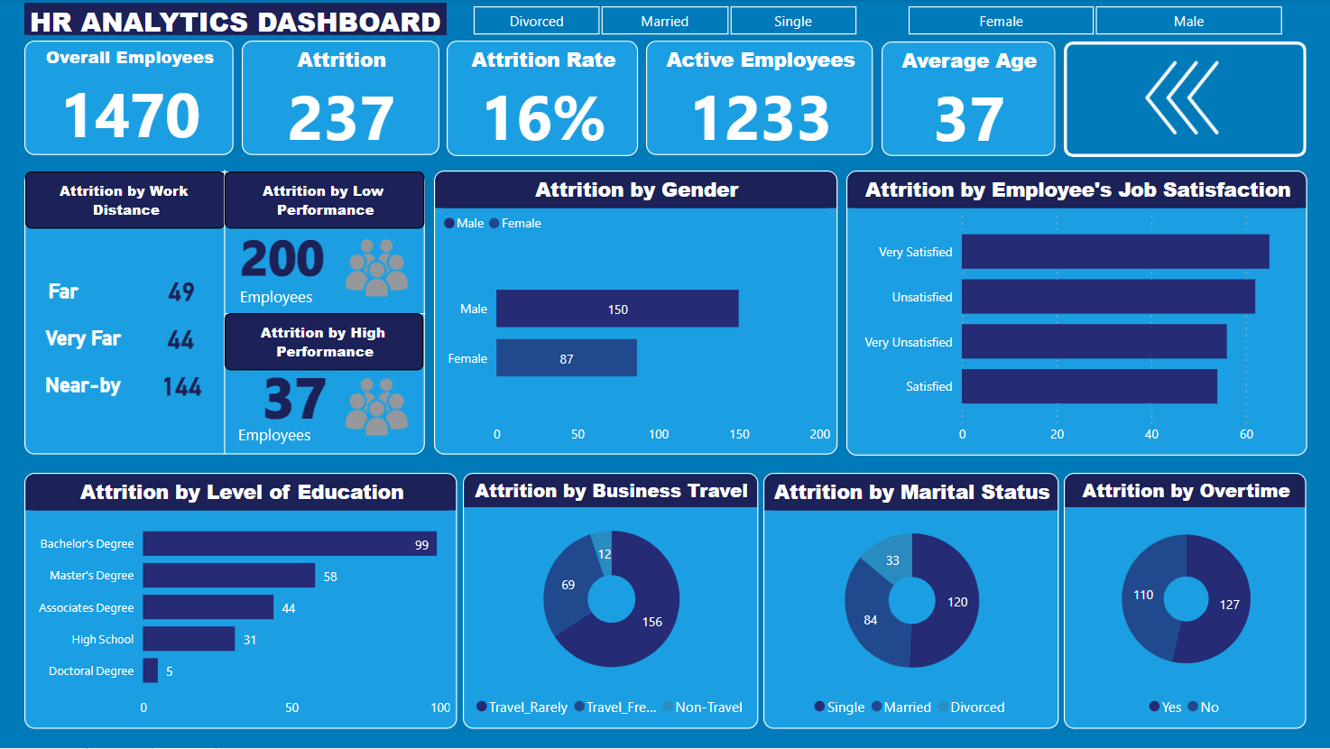
Dashboard

Slide 14
Recommendations
Since most the employees (200) leaving the job are those with low performance, the organization should organize training and development programs to help employees to acquire new skill and advance their career in the organization.
Management must assess the physical and social aspects of the workplace to ensure it is comfortable, safe and pleasant environment to work in since most people leaving the organization are those who leave near-by the work place.
It was reviled that most employees leaving the organization were those who were single. Therefore management should consider financial education programs to help single employees manage their finances effectively, as they may have different financial priorities than those with families.
Also, management must clearly communicate the expectations regarding business travel for each role within the organization. This is because most employees leaving the organization are those who rarely embark on business travel who may not be aware travel requirements.
Conduct exit interview to gather insight into the specific reasons on why employees who leave or want to leave the organization and use the feedback to make targeted improvement

Slide 15
References
The source of data used for this analysis can be found

